Slide 1
STOCK MARKET PREDICTION USING ML
-Sayantika Chowdhury(E23CSEU2165)
-Tanya Mishra( E23CSEU2161 )
-Ishita Shrivastava(E23CSEU2190)

Slide 2



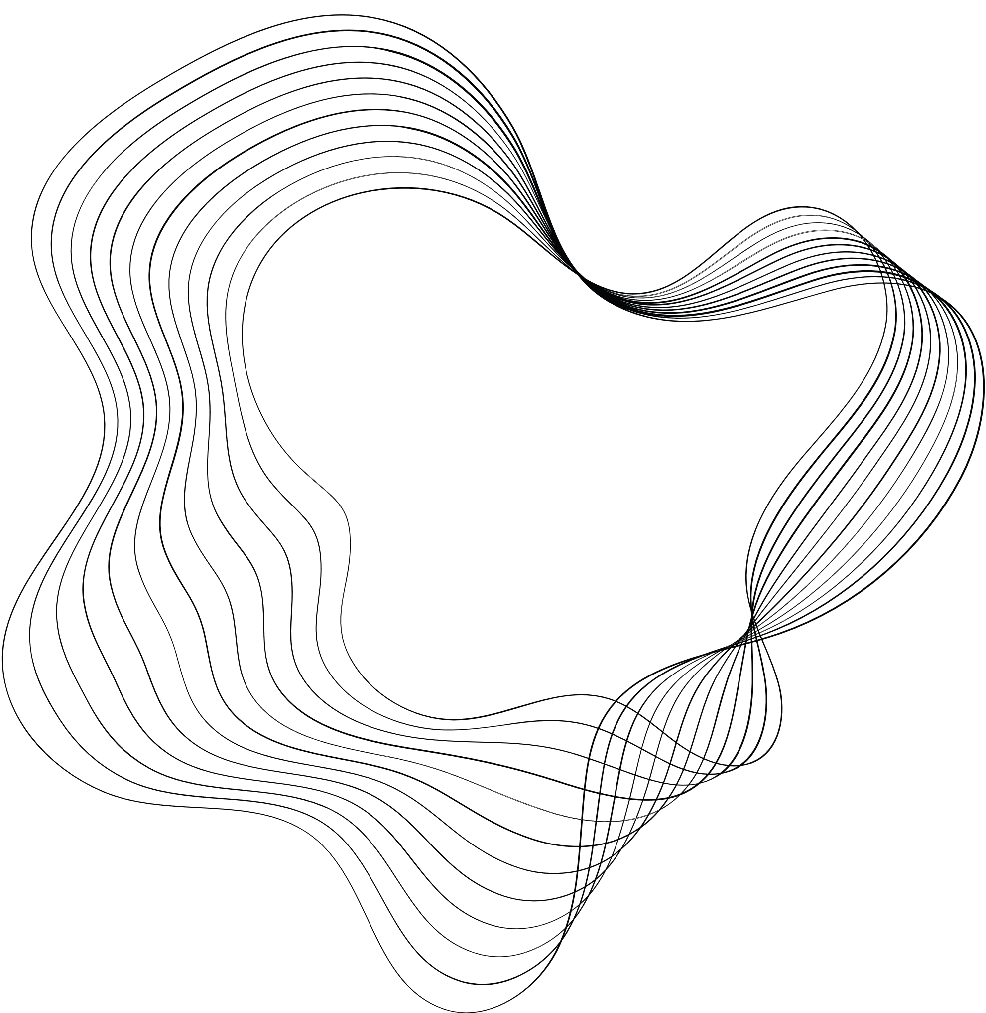
INTRODUCTION
The primary objective of this project is to predict stock prices using historical stock data. By employing advanced machine learning techniques and visualization tools, the project seeks to provide insights into market trends and enable users to make informed investment decisions. The motivation for this project stems from the growing interest in leveraging AI to improve financial forecasting accuracy. The main contributions include the development of a predictive model using Long Short-Term Memory (LSTM) networks and the integration of Streamlit for a user-friendly interface.

Slide 3

RELATED SURVEY
A thorough review of existing stock market prediction models highlights various traditional methods such as ARIMA and GARCH and modern approaches using machine learning. However, a gap remains in effectively combining real-time data, deep learning techniques, and interactive visualizations. This project addresses these gaps by using LSTM networks, which are adept at capturing temporal dependencies in sequential data, and providing real-time visualization through Streamlit.

Slide 4
Datasets
The dataset comprises historical stock data retrieved from Yahoo Finance (yfinance library). The data spans from January 1, 2012, to December 31, 2024, covering essential features such as opening price, closing price, high, low, and volume.

Slide 5
Data Preprocessing
Resetting the index for easier manipulation.
Calculating moving averages (50-day, 100-day, 200-day) for trend analysis.
Splitting the dataset into training (80%) and testing (20%) subsets.
Normalizing data using MinMaxScaler to scale values between 0 and 1, which is essential for faster and more accurate LSTM training.
Handling missing values by dropping rows containing NaNs.

Slide 6

Methodology
Hardware and Software Requirements
Hardware
Software
CPU: Intel Core i5 or higher
Python 3.9+
IDE: Jupyter Notebook and Visual Studio Code
RAM: 8 GB or more
GPU: Optional (for faster LSTM training)
Libraries: numpy, pandas, matplotlib, tensorflow/keras, yfinance, streamlit

Slide 7

PERFORMANCE METRICS
The project evaluates performance using:
Mean Squared Error (MSE): Measures the average squared difference between predicted and actual prices.
Visualization: Overlaying predicted vs. actual prices to assess trends visually.

Slide 8
Results and Analysis
The LSTM model was trained over 50 epochs with a batch size of 32, resulting in improved accuracy over time. Key findings include:
The 100-day and 200-day moving averages provided significant insights into long-term trends.
The model accurately predicted stock prices during stable market conditions but exhibited slight deviations during volatile periods.
Interactive visualizations using Streamlit demonstrated the alignment between predicted and actual prices, enabling intuitive assessments.
Visual results include:
Price vs. MA50: Showcased short-term trends.
Price vs. MA50 vs. MA100: Highlighted medium-term trends.
Price vs. MA100 vs. MA200: Provided long-term trend analysis.
Predicted vs. Actual Prices: Highlighted the model’s predictive accuracy.

Slide 9
Conclusions and Future Works
Achievements
Successfully implemented an LSTM-based predictive model capable of capturing complex patterns in stock data.
Integrated interactive visualizations and user inputs through Streamlit for practical usability.
Highlighted the importance of moving averages in trend detection.
Future Directions
Incorporate additional financial indicators such as RSI or MACD for enhanced predictive capabilities.
Extend the model to multi-stock or portfolio prediction.
Deploy the model using cloud services for real-time stock predictions.
Explore more advanced deep learning architectures, such as transformers, for improved accuracy in highly volatile conditions.

Slide 10
https://github.com/Sayantika2327/STOCK_MARKET_PREDICTIO_USING_ML.git

Slide 11
THANK YOU

